Slide 1

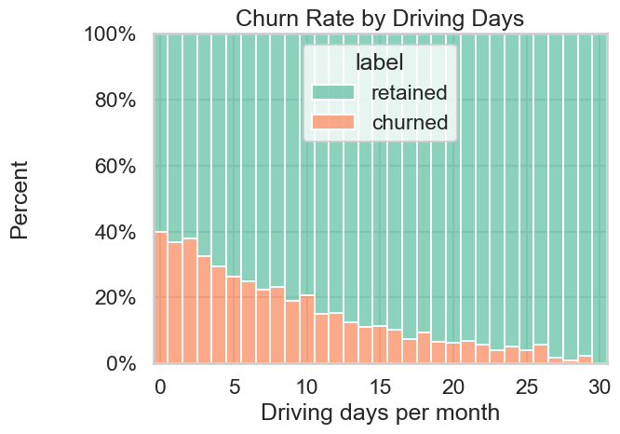
User Churn Project | Exploratory Data Analysis
Prepared by Hannah Bennett for the Waze Leadership Team
The Waze data team is currently assessing user churn and analyzing what factors affect user churn vs. retention. Using exploratory data analysis, the team has uncovered several insights that may help proactively target users likely to churn and improve overall retention.
This report offers details from our analysis and list insights that will impact the future development of this project.
The data team has followed the plan set out for the analysis and evaluation of the dataset in order to uncover insights into user churn.
The provided dataset has been cleaned and exploratory data analysis has begun.
Various charts have been created to visualize the factors within the dataset.
An additional column evaluating the km driven per driving day has been added to the dataset.
Churn rate is consistent across device type.
The number of active days (when the app is opened) is consistently higher than the number of days the app is used for driving.
Very few users use the app every day, and the number of days the app is used for driving drops off sharply after 20 days.
Users churn less the more days per month they use the app. Churned users are more heavily represented among newer users, while retained users are more common in those with a longer app history.
Investigate the discrepancies between the number of sessions, the driving days, and the activity days.
Continue to explore user profiles and data with the larger data team for additional insights on the churn rate, specifically among the long-distance drivers.
Run deeper statistical analyses on the variables in the data to determine their impact of churn rate vs. retention.
Create a predictive model to assess the probability of user churning.

